Slide 1
CSL 2060
Software Engineering
Course Project
Timely
(Google Chrome Extension)

Slide 2
Project Objective and Status
Objective:
We require an google chrome extension to allow the users to track their daily time spend on each website they visit. There should be a way to add/edit restriction on websites, set ignore list of domains, set notification time on websites and also it should store the users’ time spent on each website so as to present the analytics in form of charts and tabular data to the user.
Status:
Completed

Slide 3
Team Details & Contributions
Dev Goel (B20CS090): Worked on coding the HTML pages of index and options page and also wrote the CSS for these pages. Then, also contributed in the manifest.json file. Then, made the backend using javascript so for these I wrote the code for common.js, setting.js, webact.js and activity.js. Also, contributed to the README file.
Approximate line of Codes written: 1500
Ravi Ramavat (B20CS053): Worked on coding the HTML page of settings page and also wrote the CSS for this page. Then, also contributed in the manifest.json file. Then, made the backend using javascript so for these I wrote the code for block.js, restriction.js, storage.js, timeInterval.js, url.js and ui.js. Also, contributed to the README file.
Approximate line of Codes written: 1450
Note: Though the contribution has been told specific to the member but each module’s code has been written after discussion with each other.

Slide 4
Link to the Repository
https://github.com/Dev-Goel/CSL2060-Software-Engineering-Project-Timely

Slide 5
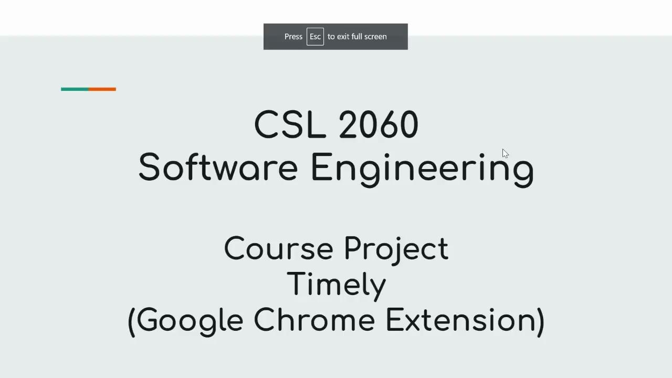
Video Link
https://drive.google.com/file/d/1M73KVW39sYlaMOZm_2xw4g6TQ4cIiIDN/view?usp=sharing

Slide 6


